Slide 1
FlexBox 1D
Joseph Suchan
Hyndavi Musiaptla
Abhinay Kaitha
Mushafiq Fakki
Subash Veeramachaneni

Slide 2
What is Flexbox?
The Flexible Box Layout Module, makes it easier to design flexible responsive layout structure without using float or positioning.

Slide 3
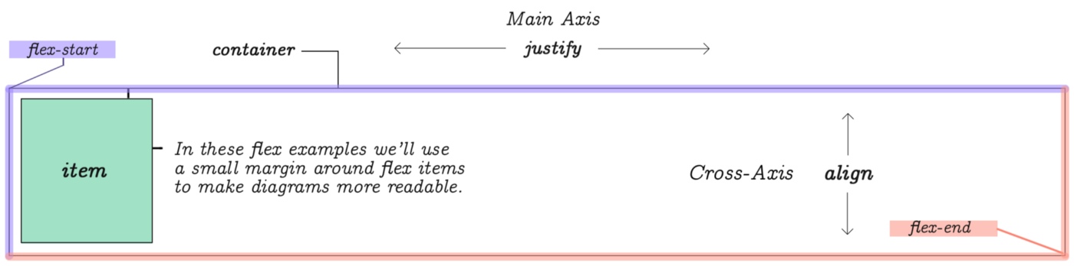
Flexbox Elements
To start using the Flexbox model, you need to first define a flex container.
The element above represents a flex container with one flex item.

Slide 4
Structure :
Parent(flex container)
Children(flex item)
Two Axis:
Main axis(justify)
Cross axis(align)

Slide 5
Flexbox Layout
.flex-container { display: flex; }

Slide 6
Flexbox Properties
The flex container properties are:
flex-direction
flex-wrap
flex-flow
justify-content
align-items
align-content

Slide 7
Flex-direction property
The flex-direction property defines the container wants to stack the flex items.
Row
Row-reverse
column
Column-reverse

Slide 8
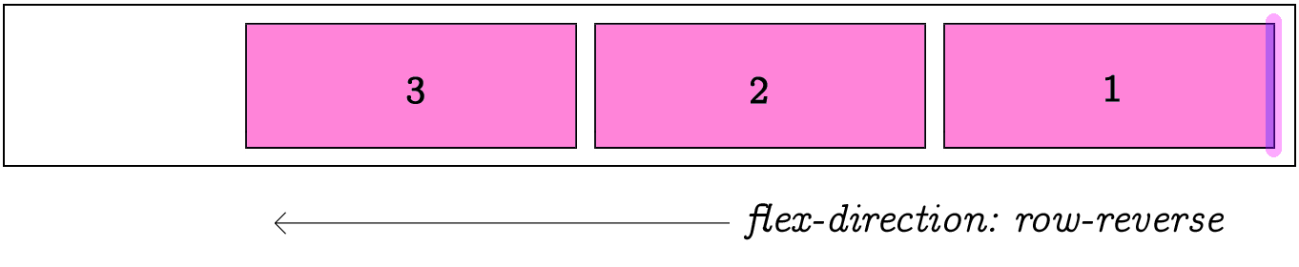
.flex-container { display: flex; flex-direction: row-reverse; }

Slide 9
The flex-wrap Property
The flex-wrap property specifies whether the flex items should wrap or not.
Wrap
Nowrap
Wrap-reverse

Slide 10
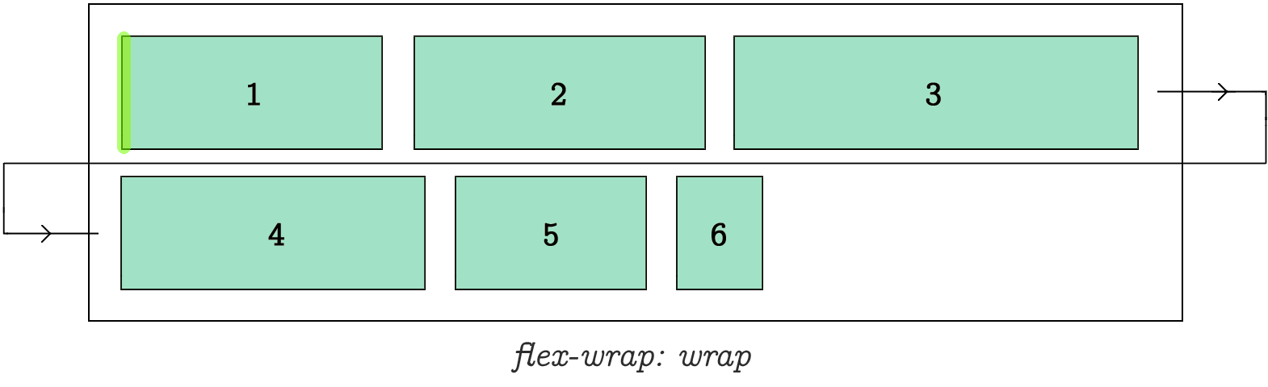
.flex-container { display: flex; flex-wrap: wrap; }

Slide 11
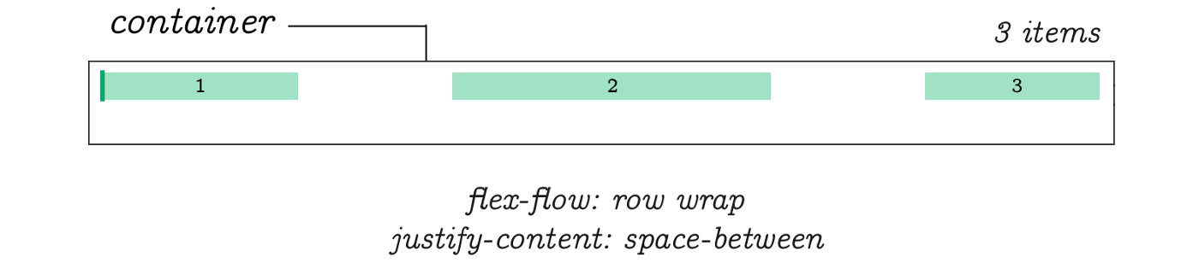
The flex-flow Property
It is for setting both flex-direction and flex-wrap properties.
.flex-container { display: flex; flex-flow: row wrap; }

Slide 12
The justify-content Property
It is used to align the flex items
Center
Flex-start
Flex-end
Space-around
Space-between

Slide 13
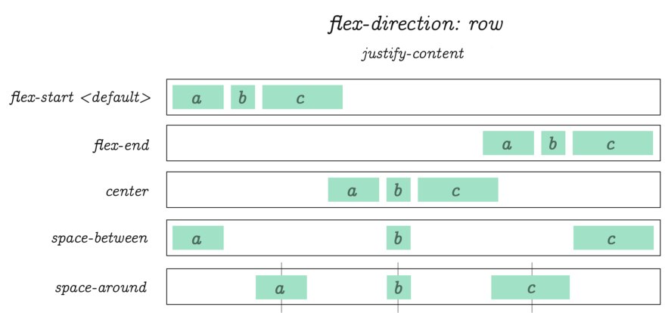
.flex-container { display: flex; justify-content: center; }

Slide 14
The align-items Property
It is used to align the flex items vertically.
Center
Flex-start
Flex-end
Stretch
Baseline

Slide 15
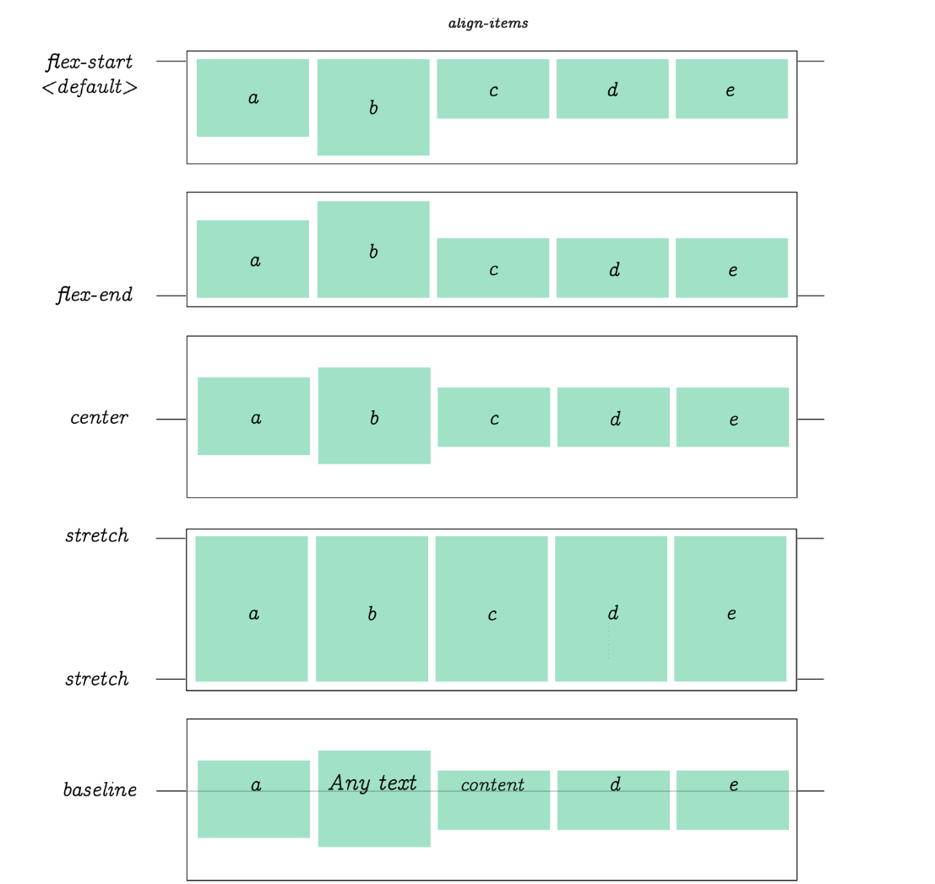
.flex-container { .flex-container { display: flex; height: 200px; align-items: center; }

Slide 16
The align-content Property
It is used to align the flex lines.
Space-between
Space-around
Center
Flex-start
Flex-End

Slide 17
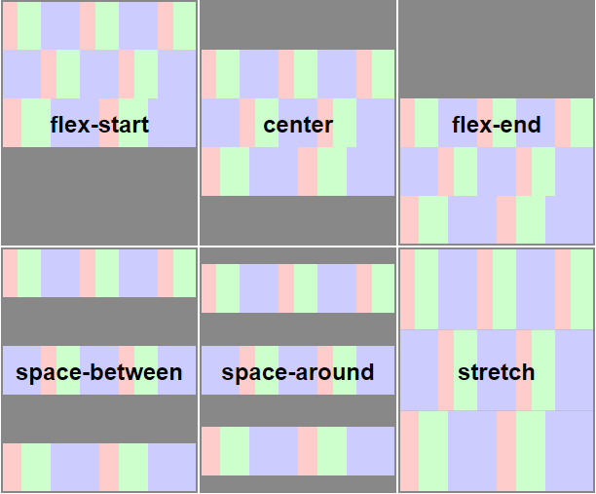
.flex-container { display: flex; height: 600px; flex-wrap: wrap; align-content: center; }

Slide 18

Perfect Centering
Set both the justify-content and align-items properties to center, and the flex item will be perfectly centered.
.flex-container { display: flex; height: 300px; justify-content: center; align-items: center; }

Slide 19
Child Elements (Items)
The flex item properties are:
order
flex-grow
flex-shrink
flex-basis
flex
align-self

Slide 20

<div class="flex-container"> <div>1</div> <div>2</div> <div>3</div> <div>4</div> </div>

Slide 21

The order Property
The order property specifies the order of the flex items.
The first flex item in the code does not have to appear as the first item in the layout.
<div class="flex-container"> <div style="order: 3">1</div> <div style="order: 2">2</div> <div style="order: 4">3</div> <div style="order: 1">4</div> </div>

Slide 22

The flex-grow Property
The flex-grow property specifies how much a flex item will grow relative to the rest of the flex items.
<div class="flex-container"> <div style="flex-grow: 1">1</div> <div style="flex-grow: 1">2</div> <div style="flex-grow: 8">3</div> </div>

Slide 23

The flex-shrink Property
It specifies how much a flex item will shrink relative to the rest of the flex items.
<div class="flex-container"> <div>1</div> <div>2</div> <div style="flex-shrink: 0">3</div> <div>4</div> <div>5</div> <div>6</div> <div>7</div> <div>8</div> <div>9</div> <div>10</div> </div>

Slide 24

The flex-basis Property
It specifies the intial length of a flex item.
<div class="flex-container"> <div>1</div> <div>2</div> <div style="flex-basis: 200px">3</div> <div>4</div> </div>

Slide 25
The flex Property
The flex property is a short hand property for flex-grow,flex-basis and flex-shrink property
<div class="flex-container"> <div>1</div> <div>2</div> <div style="flex: 0 0 200px">3</div> <div>4</div> </div>

Slide 26
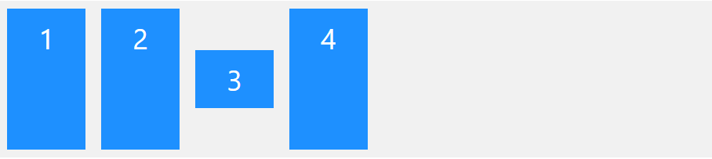
The align-self Property
It specifies the alignment for the selected item inside the flexible container
<div class="flex-container"> <div>1</div> <div>2</div> <div style="align-self: center">3</div> <div>4</div> </div>

Slide 27
THANK YOU

